Slide 1

PERFORM CHILD PROTECTION DUTIES RELEVANT TO THE TOURISM INDUSTRY
D1.HRS.CL1.20 D1.HOT.CL1.13 D2.TCC.CL1.14
Notes:
Trainer introduces the unit.

Slide 2

1. Perform Child Protection Duties Relevant to the Tourism Industry
This Unit is comprised of three Elements :
Identify the issue of sexual exploitation of children by tourists (otherwise known as child sex tourism)
Describe, national, regional and international actions to prevent the sexual exploitation of children by tourists
Describe actions that can be taken in the workplace to protect children from sexual exploitation by tourists
Notes:
Trainer Notes: Trainer advises students that this Unit comprises three Elements, as listed on the slide
explaining:
• Each Element comprises a number of Performance Criteria which will be
identified throughout the class and explained in detail
• Students can obtain more detail from their Trainee Manual
• The course presents advice and information but, where their workplace
requirements differ to what is presented, the workplace practices and standards
must be observed.

Slide 3
Assessment
Assessment for this Unit may include:
Oral Questions
Written Questions
Work Projects
Workplace observation of practical skills
Practical Exercises
Formal report from employer/supervisor.
Notes:
Trainer Notes: Trainer advises students that assessment for this Unit may take several forms all
of which are aimed at verifying they have achieved competency for the Unit as
required.
Trainer indicates to students the methods of assessment that will be applied to them for this Unit.

Slide 4
1. Identify the issue of sexual exploitation of children by tourists
Performance Criteria:
1.1 Define the problem of child sexual exploitation of children by tourists (otherwise known as child-sex tourism)
1.2 Describe the impact of child sexual exploitation on children, communities and the hotel and travel industries
1.3 Identify suspicious behaviors that may be exhibited by child sex tourists
Notes:
Trainer Notes: Trainer identifies for students the Performance Criteria for this Element, as listed
on the slide.

Slide 5
2. Describe national, regional and international actions to prevent the sexual exploitation of children by tourists
Performance Criteria:
2.1 Locate and become familiar with the United Nations Convention on the Rights (UNCRC) of the Child and the main UN Articles relating to the rights of all children to be safe from sexual exploitation
2.2 Examine national, regional and international initiatives to prevent the sexual exploitation of children by tourists
2.3 Identify reporting mechanisms if suspicious behavior is observed
Notes:
Trainer Notes: Trainer identifies for students the Performance Criteria for this Element, as listed
on the slide.

Slide 6
3. Describe actions that can be taken in the workplace to protect children from sexual exploitation by tourists
Performance Criteria:
3.1 Prepare a list of actions that can be taken by staff working in each labor division of the hotel and travel industries to prevent the sexual exploitation of children by tourists
Notes:
Trainer Notes: Trainer identifies for students the Performance Criteria for this Element, as listed
on the slide.
Class Activity – General discussion
Trainer leads a general class discussion on responding to Child Sex Tourism
in the workplace asking questions such as:
• Are you aware of Child Sex Tourism in your workplace, local area or region?
• If yes, how prevalent do you believe Child Sex Tourism is in your workplace, local area or region?
• Are you aware of local and international laws regarding Child Sex Tourism?
• How important is it for the hotel and travel industries to introduce child protection measures across all areas of the workplace?
• Does your workplace currently have policies, procedures and training in place to identify and eliminate Child Sex Tourism from your workplace? If yes, please describe.

Slide 7
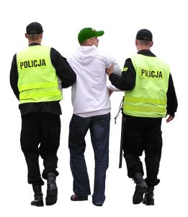
1.1 Define the problem of child sexual exploitation of children by tourists (otherwise known as child-sex tourism)
According to UNICEF, 3 million children are victims of sexual exploitation every year
Under the UNICEF definition a Child is anyone under the age of 18.
Notes:
Trainer Notes:
Trainer to discuss the above points
Trainer to explain that if the ‘definition of a child’ is younger than the age of 18 in the country where you operate then you must follow the local definition.

Slide 8

1.1 Define the problem of child sexual exploitation of children by tourists (otherwise known as child-sex tourism)
Child Sex Tourism refers to the sexual abuse of children by offenders who normally live outside the region where the abuse is occurring
Offenders could be tourists, expatriates, foreign workers, business travelers or anyone who is in the area for a short-term period.
Notes:
Trainer Notes and Activity:
Trainer to refer students to the Training Manual for a more detailed definition of Child Sex Tourism
Trainer to discuss the above points
Activity: It is suggested that the Trainer download and go through with the students the Childwise Free Downloadable Publication, ‘Wise Up’ to Child Sexual Abuse available at:
http://www.childwise.net/Resources/online-publications.html)

Slide 9
1.1 Define the problem of child sexual exploitation of children by tourists (otherwise known as child-sex tourism)
Why is Child Sex Tourism Growing?
It has become increasingly difficult for situational and preferential abusers and pedophiles to target children in richer countries due to:
closer scrutiny in workplaces
police checks and strong laws
policies and procedures set up to eliminate situations where child abuse may occur.
Notes:
Trainer Notes:
Trainer to explain that, due to the above reasons, child sex offenders are now looking to less developed countries to access vulnerable children
Trainer to discuss the above points

Slide 10
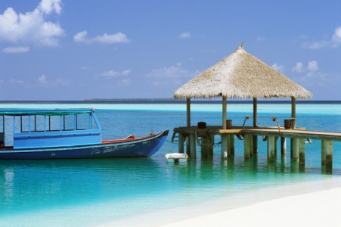

1.1 Define the problem of child sexual exploitation of children by tourists (otherwise known as child-sex tourism)
Why Do Child Sex Tourists Choose Less Developed Countries?
These countries may not have a strong enforcement system and may be going through a myriad of development issues, with Child Protection being only one of the concerns a country may be facing.
Notes:
Trainer Notes:
Trainer to explain that ‘In the past many of these offenders have found themselves in positions of power where they can access children freely but due to a stronger commitment to stamp out child abuse in their own countries, they are now moving to areas where there are vulnerable children and perhaps lax law enforcement and corruption’
Trainer to discuss the above points

Slide 11
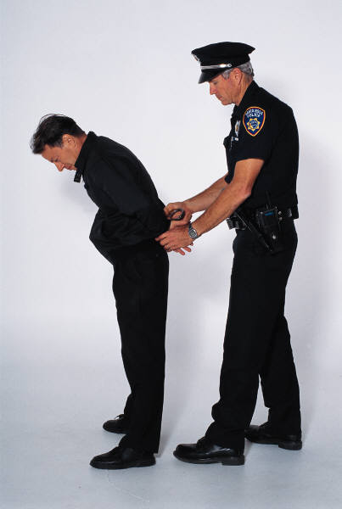
1.1 Define the problem of child sexual exploitation of children by tourists (otherwise known as child-sex tourism)
Offender Behavior:
Offenders are frequenting hotels, bars, restaurants and other hospitality and tourism venues where children can be accessed and abused without the threat of being identified, caught and prosecuted.
Notes:
Trainer Notes:
Trainer to discuss the above point

Slide 12

1.1 Define the problem of child sexual exploitation of children by tourists (otherwise known as child-sex tourism)
The Internet’s Influence on CST:
The internet has played an integral part in the sexual exploitation of children by foreigners, as it has allowed offenders, both situational and preferential, as well as pedophiles:
to access and share information about destinations where there are vulnerable children and lax law enforcement.
Notes:
Trainer Notes:
Trainer to explain that ‘The internet has also allowed these offenders to form networks that keep each other up to date about ‘new’ destinations where children can be accessed easily as well as allowing offenders to share videos and photographs of abused children’
Trainer to discuss the above points

Slide 13


1.1 Define the problem of child sexual exploitation of children by tourists (otherwise known as child-sex tourism)
The Internet’s Influence on CST:
The internet has allowed offenders to share videos and photographs of abused children
Many of these images are stored, traded, sold and distributed via offender network .
Notes:
Trainer Notes:
Trainer to discuss the above points

Slide 14

1.1 Define the problem of child sexual exploitation of children by tourists (otherwise known as child-sex tourism)
The Internet’s Influence on CST:
The production and distribution of these images furthers the ongoing exploitation of children and inevitably promotes the visitation by offenders to vulnerable communities
These offenders are also frequenting Hotel and Travel businesses where they can access children without fear of identification, arrest and prosecution.
Notes:
Trainer Notes:
Trainer to discuss the above points

Slide 15
1.1 Define the problem of child sexual exploitation of children by tourists (otherwise known as child-sex tourism)
The Internet’s Influence on CST:
Those who make and use pornographic images of children ‘perpetuate the exploitation of children by creating a demand for more images’ (Reference: http://ecpat.net/EI/Programmes_ICT.asp 16/1/2012)
The very fact that these images have been made means that vast numbers of children have already been abused
Once they are distributed and viewed the abuse grows dramatically. It also aids in the offenders becoming ‘desensitized’ to child abuse.
Notes:
Trainer Notes:
Trainer to discuss the above points

Slide 16
1.1 Define the problem of child sexual exploitation of children by tourists (otherwise known as child-sex tourism)
The Internet’s Influence on CST:
‘The growth of the Internet is creating more commercial opportunities for child exploiters and pornographers and the rapid development of new technologies are facilitating the development and reach of distribution networks’ . (Reference: http://ecpat.net/EI/Programmes_ICT.asp 16/1/2012)
Notes:
Trainer Notes:
Trainer to discuss the above points

Slide 17
1.1 Define the problem of child sexual exploitation of children by tourists (otherwise known as child-sex tourism)
The Internet’s Influence on CST:
Inevitably there is a direct link to the making of these images and the abuse of children that occurs in their production, with the growth of child sex tourism and the industry this creates.
Notes:
Trainer Notes and Activity:
Please ask the students not to search for child pornography on the internet as an exercise to see if it actually exists and is assessable as this may lead to them being investigated and also acts as a form of voyeurism that perpetuates the existence of child pornography on the internet
Trainer to discuss the above point
Activity: Trainer to discuss with the class what is it about the internet that has allowed the CSEC and CST to grow.

Slide 18
1.1 Define the problem of child sexual exploitation of children by tourists (otherwise known as child-sex tourism)
The Growth in International Travel:
Another area impacting dramatically on the increase in child sexual abuse and child trafficking is the growth in international travel and budget airlines over the past 10 – 15 years
More people are travelling than ever before and often this is from First World Countries to Third World and Developing Countries.
Notes:
Trainer Notes:
Trainer to discuss the above points
Trainer to explain that due to the above ‘This has led to an explosion in the sexual abuse of children, as more and more offenders are accessing vulnerable children in these new budget destinations’

Slide 19

1.1 Define the problem of child sexual exploitation of children by tourists (otherwise known as child-sex tourism)
The Hotel and Travel Industries Can Assist:
The Hotel and Travel Industries can play a vital part in the elimination of child sex tourism, regardless of location and law enforcement issues.
Notes:
Trainer Notes:
Trainer to discuss the above points

Slide 20

1.1 Define the problem of child sexual exploitation of children by tourists (otherwise known as child-sex tourism)
The First Step:
Identify whether child sexual exploitation is a direct issue on the business’ premises and grounds or operating locality.
Notes:
Trainer Notes:
Trainer to discuss the above point

Slide 21
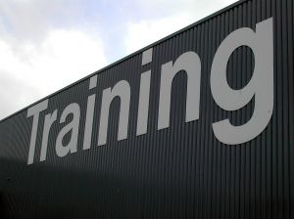
1.1 Define the problem of child sexual exploitation of children by tourists (otherwise known as child-sex tourism)
The Second Step:
Develop policies, procedures and training (in tandem with Child Protection Agencies) for all business operations and staff, that identifies the potential for offending to occur and eliminates it completely from their business.
Notes:
Trainer Notes:
Trainer to discuss the above point

Slide 22
1.2 Describe the impact of child sexual exploitation on children, communities and the hotel and travel industries
Child Sex Tourism is an abhorrent act, that is morally, legally and physically corrupt
Children who are abused sexually suffer a lifetime of ongoing physical, emotional and social impacts
Child Sexual abuse is a crime no matter where and when it happens and that it is never ever the child’s fault
The person abusing the child is entirely responsible.
Notes:
Trainer Notes:
Trainer to discuss the above points
Trainer to discuss that children are just that and that the offender has all the power and influence, regardless of the child’s behavior or life situation

Slide 23

1.2 Describe the impact of child sexual exploitation on children, communities and the hotel and travel industries
Please refer to the Training Manual for a detailed description of the impact of the CSEC.
Notes:
Trainer Notes and Activity:
Trainer to refer the class to the Training Manual and discuss each point with students

Slide 24

1.2 Describe the impact of child sexual exploitation on children, communities and the hotel and travel industries
Who are the Victims?
Please refer to the Training Manual for a detailed description of the victims of CST.
Notes:
Trainer Notes and Activity:
Trainer to refer the class to the Training Manual and discuss each point in class

Slide 25

1.2 Describe the impact of child sexual exploitation on children, communities and the hotel and travel industries
The Impact on Children:
The negative impacts on children of CST is profound, lifelong and dramatic.
Notes:
Trainer Notes:
Trainer to discuss the above points

Slide 26
1.2 Describe the impact of child sexual exploitation on children, communities and the hotel and travel industries
The Impact on Children:
‘The physical violence involved in the sexual exploitation of a child results in injury, pain and fear, while the acute psychological distress of sexual exploitation results in guilt, low self-esteem, depression and, in some instances, suicide’
‘Children are also more vulnerable to sexually transmitted infections (STI), including HIV/AIDS’.
Reference: Title: Combating Child Sex Tourism: FAQs, http://ecpat.net/EI/CST_Publications.asp Page 16. 16/1/2012. An ECPAT International Publication. 2008.
Notes:
Trainer Notes:
Trainer to discuss the above points

Slide 27
1.2 Describe the impact of child sexual exploitation on children, communities and the hotel and travel industries
The Impact CST has on Children and Communities:
The CSEC is not something that happens and then is forgotten about by the children, their families and communities
Many CST victims are often tainted by their abuse experiences and many communities are unfortunately unwilling to accept them.
Notes:
Trainer Notes:
Trainer to explain that, due to the above, this inevitably leads to the further breakdown of families and communities.
Trainer to discuss the above points

Slide 28
1.2 Describe the impact of child sexual exploitation on children, communities and the hotel and travel industries
The Impact CST has on Children and Communities:
Socially, for the children this can have an ongoing devastating effect such as:
Difficulty in obtaining education
Lack of community support and understanding
A criminal record
The inability to develop ‘normal’ friendships
The inability to interact socially
The inability to gain worthwhile employment and hence financial independence and stability.
Notes:
Trainer Notes and Activity:
Trainer to discuss the above points
Activity: Trainer to discuss each of the above points with the class and ask why each of these may be an issue for an abused child or an adult that was abused as a child

Slide 29
1.2 Describe the impact of child sexual exploitation on children, communities and the hotel and travel industries
The Impact CST has on Children and Communities:
Physically, the health issues many child victims suffer also impact not only on themselves but on their communities
Communities with limited means and experience have to care for sick children and adults (that as children were abused) and many of these same communities have seen an explosion in HIV and STI rates.
Notes:
Trainer Notes:
Trainer to discuss the above points

Slide 30

1.2 Describe the impact of child sexual exploitation on children, communities and the hotel and travel industries
The Impact CST has on Children and Communities:
In many communities the discussion of sex, prostitution and particularly child sex is taboo, therefore child victims are often forced to suffer in silence through no fault of their own.
Notes:
Trainer Notes and Activity:
Trainer to discuss the above points
Activity: Trainer to discuss with class whether the discussion of sex is taboo in their local communities. If so, what ways that are culturally appropriate could be used to discuss the issue of CST and the CSEC?

Slide 31
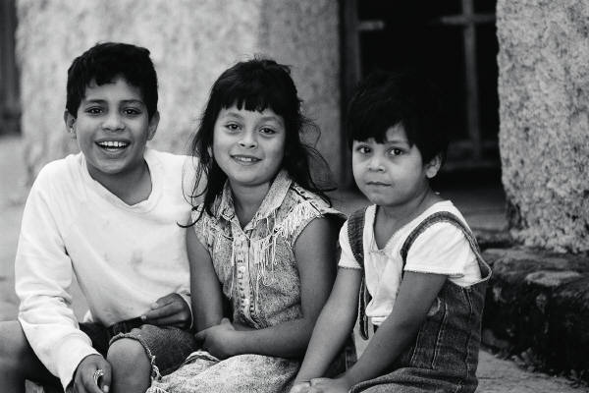
1.2 Describe the impact of child sexual exploitation on children, communities and the hotel and travel industries
The Impact CST has on Children and Communities:
The impact on communities of the CSEC is negative and substantial, as is the loss of child innocence, the breakdown of morals and social norms, the growth in crime associated with the CSEC and the attraction of these vulnerable communities to offenders and child pornographers becomes apparent.
Notes:
Trainer Notes:
Trainer to discuss the above point

Slide 32
1.2 Describe the impact of child sexual exploitation on children, communities and the hotel and travel industries
The Impact CST has on Children and Communities:
Additionally, there is also the lost future opportunities for these child victims to become worthwhile contributing members of a functioning and healthy community.
Notes:
Trainer Notes:
Trainer to discuss the following points based on the above description:
Child victims of sexual abuse need to be protected, supported and provided with ongoing health care and educational opportunities.
However, all of these options are costly and can never undo the harm.
The best course of action for a community and the Hotel and Travel Industry within those communities is to work towards the elimination of CST before the impacts are felt by all concerned.

Slide 33
1.2 Describe the impact of child sexual exploitation on children, communities and the hotel and travel industries
The Impact on the Hotel and Travel Industries:
It is common knowledge amongst the travel and hotel industries that many genuine tourists are not willing to visit areas where child sex tourism (or sex tourism) is openly occurring
The majority of tourists will avoid such destinations, hotels, restaurants, bars and other businesses that allow such activities to occur
Notes:
Trainer Notes:
Trainer to discuss the above points

Slide 34

1.2 Describe the impact of child sexual exploitation on children, communities and the hotel and travel industries
Direct Impacts on the Hotel and Travel Industries:
Refer to the Training Manual for a comprehensive list of Impacts.
Notes:
Trainer Notes and Activity:
Refer students to the Training Manual for a comprehensive list of Impacts and discuss each point in detail asking the students why they think that each of these points will impact on the Hotel and Travel Industries?
Other Suggestions for the above: include showing the students Trip Advisor Reviews and copies of Newspaper and Magazine articles regarding Child Sex Tourism

Slide 35

1.2 Describe the impact of child sexual exploitation on children, communities and the hotel and travel industries
Legal Obligations for the Hotel and Travel Industries:
Refer to the Training Manual for a comprehensive list of Legal Obligations.
Notes:
Trainer Notes and Activity:
Trainer to direct students to the Training Manual and take students through each of the legal obligations explaining each point as necessary

Slide 36
1.3 Identify suspicious behaviors that may be exhibited by child sex tourists
What Do Offenders Look Like?
The first and most important thing to remember is that there is no stereotypical offender
They can come from anywhere, be male or female, married or single, wealthy or of a lower socio–economic and educational status
There is not one physical feature, behavior type or social pattern that will distinguish a child sex tourist.
Notes:
Trainer Notes:
Trainer to discuss the above points

Slide 37
1.3 Identify suspicious behaviors that may be exhibited by child sex tourists
What We Do Know About Offenders:
95% of Child Sex Offenders are male and they can be married and have children of their own
Up to a third of offences are committed by adolescents
Most sexual offences are committed by men between the ages of 25 – 40 years.
Notes:
Trainer Notes:
Trainer to discuss the above points

Slide 38
1.3 Identify suspicious behaviors that may be exhibited by child sex tourists
What We Do Know About Offenders:
There are three internationally recognized types of offenders:
Situational Child Sex Tourist
Preferential Child Sex Tourist
Pedophile .
(see the Glossary at the beginning of the Training Manual for a description of each offender type)
Notes:
Trainer Notes and Activity:
Trainer to discuss the above points and refer class to the Glossary of the Training Manual for a description of each offender type

Slide 39
1.3 Identify suspicious behaviors that may be exhibited by child sex tourists
The Variables for Offending:
Refer to the Training Manual for a Comprehensive List.
Notes:
Trainer Notes and Activity:
Trainer to refer class to the Training Manual for a description of each offender type
Trainer to discuss each Variable and ask the class ‘why do each of these variables impact on CST’s growth?’

Slide 40
1.3 Identify suspicious behaviors that may be exhibited by child sex tourists
Offenders Modus Operandi:
Refer to the Training Manual for a comprehensive list.
Notes:
Trainer Notes and Activity:
Trainer to refer class to the Training Manual for a description of an offender’s Modus Operandi
Trainer to discuss each Variable and ask the class ‘why do each of these variables impacts on CST’s growth?’

Slide 41
1.3 Identify suspicious behaviors that may be exhibited by child sex tourists
Suspicious Behavior that can be Identified by the Hotel and Travel Industries:
While there is no stereotypical offender type, approaches to staff, contractors, suppliers and stakeholders of The Hotel and Travel Industries by potential offenders can be counteracted with:
Child Safe policies and procedures
staff training
monitoring and reporting mechanisms.
Notes:
Trainer Notes:
Trainer to discuss the above points

Slide 42
1.3 Identify suspicious behaviors that may be exhibited by child sex tourists
Suspicious Behavior that can be Identified by the Hotel and Travel Industries:
Remember that Reception Staff, Bartenders, Housekeeping Staff, Waiters and Waitresses, Porters, Doormen, Security, Tour Guides, Information Staff, Child Activity Staff, Child Minders, Swimming Pool and Beach Lifeguards, Theme Park Staff, Bus Drivers and Taxi Drivers are generally the people that those looking to procure children for sex will come into contact with.
Notes:
Trainer Notes and Activity: The Trainer could ask the class if there are any other positions in the Hotel and Travel Industries that are not included on the list above.

Slide 43

1.3 Identify suspicious behaviors that may be exhibited by child sex tourists
Opportunities for the Hotel and Travel Industries:
There is a real opportunity here for the Hotel and Travel Industries which are Child Safe businesses to stop the offending at its source and before it can progress any further and damage vulnerable children, communities and businesses.
Notes:
Trainer Notes:
Trainer to discuss the above point

Slide 44
2.1 Locate and become familiar with the United Nations Convention on the Rights (UNCRC) of the Child and the main UN Articles relating to the rights of all children to be safe from sexual exploitation
The UNCRC is an all-encompassing Child Rights document that has been enshrined in law by many of the 191 ratifying countries
This means that Child Protection is a legal obligation in most countries of the world
Even more so it is a moral obligation to protect children not only by governments but by citizens, residents, businesses and employees. In fact everyone has this obligation.
Notes:
Trainer Notes and Activity: The Trainer should familiarize themselves with the United Nations Convention on the Rights of the Child, particularly Articles 19, 27, 31, 32, 34 and 35 and refer students to the Training Manual for a detailed breakdown of each Article
The United Nations Convention on the Rights of the Child can be found here:
http://www.crin.org/docs/resources/treaties/uncrc.asp#Thirty_four
Activity 2: If time permits it is suggested that the Trainer also take the students through each of the above suggested articles and relate the importance of the Hotel and Tourism Industries adhering to these laws in their workplaces, business operations and dealings with customers.

Slide 45
2.1 Locate and become familiar with the United Nations Convention on the Rights (UNCRC) of the Child and the main UN Articles relating to the rights of all children to be safe from sexual exploitation
Understanding the UNCRC Articles and Interpreting them for the Hotel and Travel Industries:
The Hotel and Travel Industries can take important steps to adhere to the UNCRC:
through their Child Safe business operations
policies, procedures and training
monitoring and reporting functions
by working with local child protection agencies such as ECPAT, their local or regional NTA or NTO and internationally recognized NGOs to incorporate the above articles into their business practices.
Notes:
Trainer Notes:
Trainer to discuss the above points

Slide 46
2.2 Examine national, regional and international initiatives to prevent the sexual exploitation of children by tourists
There has been a huge effort over the last 20 years by governments, NGOs and various International Tourism and Hotel Organizations to work towards ending of CST
In many cases these efforts have been successful, with often an industry wide adoption of policies and procedures that educate, train, provide assistance and clear steps for an organization or business to follow to be considered ‘Child Safe’.
Notes:
Trainer Notes:
Trainer to discuss the above points

Slide 47

2.2 Examine national, regional and international initiatives to prevent the sexual exploitation of children by tourists
NGOs such as ECPAT and Childwise have worked tirelessly to develop training programs for Hotel and Tourism Industry operators and stakeholders, which are of great relevance and assistance to businesses to become and remain ‘Child Safe’.
Notes:
Trainer Notes:
Trainer to discuss above points

Slide 48

2.2 Examine national, regional and international initiatives to prevent the sexual exploitation of children by tourists
Extraterritorial Laws:
The development of Extraterritorial Laws in over 40 countries is also acting as a deterrent, although to date prosecutions have been few and the laws are somewhat difficult to implement as countries must work together and form agreements to make them work successfully.
Notes:
Trainer Notes and Activity: It is suggested that the Trainer show students the following website:
http://www.thefuturegroup.org/youwillbecaught/laws.html
This is a very good resource website that contains information on which countries have Extraterritorial Laws, has a ‘Report an Offender’ page, a list of international Partners who are fighting the CSEC, information on Health Issues and on Offenders who have been caught and prosecuted.
Activity: Break the students into groups of 3 – 4 and then if internet access is available give each of the groups one of the examples listed in the Training Manual and ask them to research this particular Global Effort and to report back to the class on their findings.
If internet access is unavailable the Trainer can download information from these sites and prepare information packs on each of these Global Efforts to give to the students to complete this activity
20 - 30 Minutes should be more than enough time for the Research part of this Activity

Slide 49

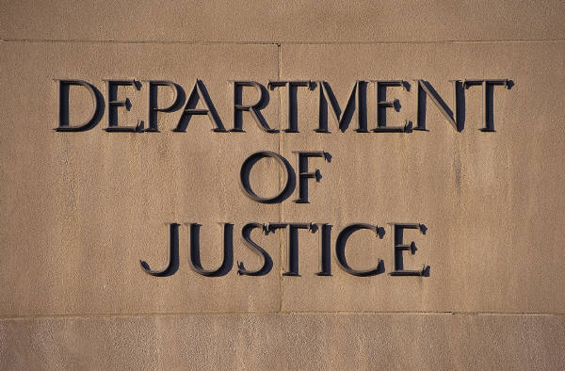
2.2 Examine national, regional and international initiatives to prevent the sexual exploitation of children by tourists
Problems:
What must be recognized is that while many laws and organizational policies exist, if local law enforcement is weak, under-resourced, corrupt or unwilling to act then no amount of international agreements and laws will end the CSEC.
Notes:
Trainer Notes:
Trainer to discuss the above point

Slide 50

2.2 Examine national, regional and international initiatives to prevent the sexual exploitation of children by tourists
Why the Hotel and Travel Industries Must Act:
Hotel and Travel Industry businesses must act to stop the CSEC as they are at the forefront of where CST is occurring on a physical level. By taking a strong business stance against the CSEC, the Hotel and Travel Industry can have a huge impact on helping to eliminate the CSEC from tourism destinations.
Notes:
Trainer Notes:
Trainer to discuss the above points

Slide 51
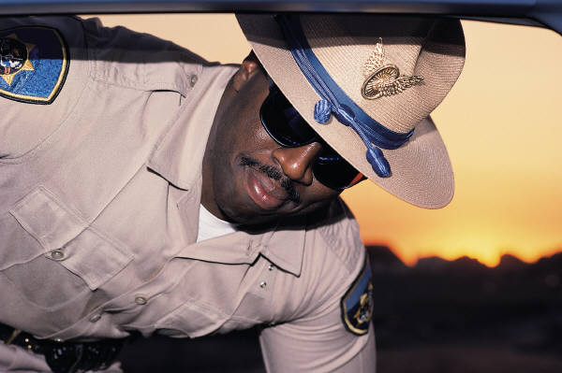
2.2 Examine national, regional and international initiatives to prevent the sexual exploitation of children by tourists
Why the Hotel and Travel Industries Must Act:
If offenders have nowhere to go to offend or places to procure vulnerable children this will dramatically decrease the current levels of CST.
Notes:
Trainer Notes:
Trainer to discuss the above points

Slide 52
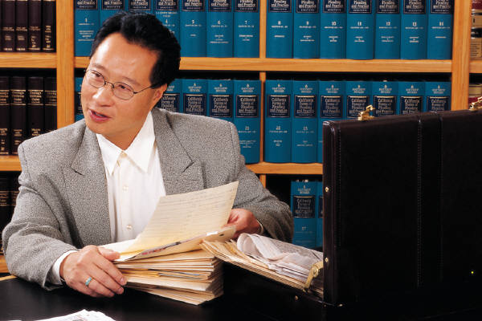
2.2 Examine national, regional and international initiatives to prevent the sexual exploitation of children by tourists
Local, National and Regional Support:
Refer to the Training Manual for a comprehensive breakdown of current Training Programs and Support Mechanisms.
Notes:
Trainer Notes and Activity:
Trainer to refer class to the Training Manual and go through each of the Support examples shown
The Trainer could research local, national and regional organizations and prepare a Handout Pack of this information for students.

Slide 53
2.2 Examine national, regional and international initiatives to prevent the sexual exploitation of children by tourists
Childwise and ECPAT have produced all sorts of awareness raising items such as t-shirts, videos, brochures, stickers, travel wallets, signage for taxis, hotels, buses, trains and other forms of local transportation
Additionally, ECPAT has many freely available publications on its website that are in multiple languages and are of invaluable assistance in the development of a Child Safe business. They can be found at: http://www.ecpat.net/EI/EI_publications.asp.
Notes:
Trainer Notes and Activity:
Trainer to discuss the above points
Trainer could access some of the local awareness raising items available and distribute to the class, asking the class if they had seen them anywhere before and where would be the best place to locate them in their workplaces?

Slide 54

2.2 Examine national, regional and international initiatives to prevent the sexual exploitation of children by tourists
What Can the Hotel and Travel Industries Do to Assist in Awareness Raising?
Refer to the Training Manual and go through each point as a class.
Notes:
Trainer Notes and Activity:
Trainer to refer students to the Training Manual and go through each point with the class asking them do their businesses already do these things? If not could they?

Slide 55
2.3 Identify reporting mechanisms if suspicious behavior is observed
Perhaps the biggest disincentive to child sex offenders, is the fear of being reported, caught, prosecuted and jailed
At the moment we know most child sex offenders act with impunity either with the direct support of others or the indirect support of those that turn away from what is happening to maintain their business earnings and customer base.
Notes:
Trainer Notes:
Trainer to discuss the above points

Slide 56

2.3 Identify reporting mechanisms if suspicious behavior is observed
There is also the general disbelief that this kind of thing is actually happening and that there are people out there who do this
Child Sex Tourism is a reality and is growing larger
For the Hotel and Travel Industries to be Child Safe, they must realize that Child Sex Tourism is real and damaging to children, communities and businesses.
Notes:
Trainer Notes:
Trainer to discuss the above points

Slide 57

2.3 Identify reporting mechanisms if suspicious behavior is observed
Accepting the Facts of CST:
With this recognition comes the realization that we are all responsible for the elimination of CST
Therefore, the Hotel and Travel Industries can play a vital part in stopping CST and the CSEC.
Notes:
Trainer Notes:
Trainer to discuss the above points

Slide 58

2.3 Identify reporting mechanisms if suspicious behavior is observed
What Happens Even if There is a Child Safe Industry and Abuse Still Occurs?
If policies, procedures, staff training and networking with other businesses fails to stop an offender, the next step is to report offenders directly to the relevant authorities and Child Protection Agencies that can act on your behalf.
Notes:
Trainer Notes:
Trainer to discuss the above points

Slide 59
2.3 Identify reporting mechanisms if suspicious behavior is observed
Reporting Mechanisms:
There are many reporting mechanisms available to the Hotel and Travel Industries
Even if you are a Child Safe business, this may not stop the offending, therefore you must act and these offenders must be reported, caught, prosecuted and jailed
This will aid in the elimination of CST from your business and region and will deter other offenders immediately.
Notes:
Trainer Notes:
Trainer to discuss the above points

Slide 60

2.3 Identify reporting mechanisms if suspicious behavior is observed
Reporting Mechanisms:
Refer to the Training Manual for a detailed list of Reporting Mechanisms.
Notes:
Trainer Notes and Activity:
Trainer to refer class to the Training Manual for a detailed list of Reporting Mechanisms and discuss them with the students
Activity: If internet access is available ask the class to research the following:
their local Child Helpline International Number
their local ECPAT or Child Protection Agency contact details
the contact details for any local authorities dealing with CST
the contact details of local embassies

Slide 61

2.3 Identify reporting mechanisms if suspicious behavior is observed
What to Report:
Refer to Page 27 of the Training Manual for a detailed breakdown of what to report if suspicious behavior is detected.
Notes:
Trainer Notes and Activity:
Trainer to refer students to Page 27 of the Training Manual and go through the ‘What to Report’ section

Slide 62
3.1 Prepare a list of actions that can be taken by staff working in each labor division of the hotel and travel industries to prevent the sexual exploitation of children by tourists
It is of vital importance that the Hotel and Travel Industries work towards implementing practical policies and procedures that will aid in ending CST
Additionally, it is important to contact and work with the various local Child Protection Agencies such as ECPAT, to assist in the development of ‘Child Safe’ business policies, Staff Training, Operating and Reporting Procedures.
Notes:
Trainer Notes:
Trainer to discuss the above points

Slide 63
3.1 Prepare a list of actions that can be taken by staff working in each labor division of the hotel and travel industries to prevent the sexual exploitation of children by tourists
Why is it Important to Be Child Safe?
Firstly, to protect the most vulnerable members of our communities, children
Secondly, it is a Legal and Moral requirement
Therefore, the Hotel and Travel Industries should develop a ‘zero policy’ regarding the CSEC and CST and make this one of their main aims.
Notes:
Trainer Notes:
Trainer to discuss the above points

Slide 64

3.1 Prepare a list of actions that can be taken by staff working in each labor division of the hotel and travel industries to prevent the sexual exploitation of children by tourists
What are the Steps to Take to Become Child Safe?
The Hotel and Travel Industries should align themselves with other Responsible and Sustainable business operators and stakeholders that are Child Safe.
Notes:
Trainer Notes:
Trainer to discuss the above points

Slide 65
3.1 Prepare a list of actions that can be taken by staff working in each labor division of the hotel and travel industries to prevent the sexual exploitation of children by tourists
What are the Steps to Take to Become Child Safe?
The Hotel and Travel Industries must implement ECPAT’s ‘Code of Conduct for the Protection of Children from Sexual Exploitation in Travel and Tourism’ into their Staff Training and Induction Programs and directly into their operating procedures http://www.thecode.org/.
Notes:
Trainer Notes and Activity: If you have internet access go to the website (if no internet access download and print copies of the Code of Conduct to give to students):
http://www.thecode.org/
Take the students through ‘The Code of Conduct for the Protection of Children from Sexual Exploitation in Travel and Tourism’ discussing each dot point and the benefits of adopting this point into the workplace.

Slide 66

3.1 Prepare a list of actions that can be taken by staff working in each labor division of the hotel and travel industries to prevent the sexual exploitation of children by tourists
Why is it Important to Be Child Safe?
The Child Safe message is also stating to staff and customers that you operate legally, morally, sustainably and responsibly. It shows that you are providing a return to your local community, not only via staff hiring and use of local goods and services but by taking a stand and protecting children from offenders and exploitation.
Notes:
Trainer Notes:
Trainer to discuss the above points

Slide 67
3.1 Prepare a list of actions that can be taken by staff working in each labor division of the hotel and travel industries to prevent the sexual exploitation of children by tourists
Why is it Important to Be Child Safe?
It will send a clear message to offenders and pornographers that they are not welcome to use your business premises
It also feeds into the greatest fear that offenders have which is being reported, arrested, prosecuted and jailed.
Notes:
Trainer Notes:
Trainer to discuss the above points

Slide 68

3.1 Prepare a list of actions that can be taken by staff working in each labor division of the hotel and travel industries to prevent the sexual exploitation of children by tourists
Actions That Can Be Taken to Prevent the CSEC by Tourists:
All Hotel and Travel Industry businesses will need to have clear Child Safe operating policies and procedures, that include staff induction and training
All staff members regardless of position should be trained in ‘Child Safe’ workplace policies and procedures.
Notes:
Trainer Notes:
Trainer to discuss the above points

Slide 69

3.1 Prepare a list of actions that can be taken by staff working in each labor division of the hotel and travel industries to prevent the sexual exploitation of children by tourists
First Actions:
Refer to the Training Manual for a detailed discussion of ‘First Actions’.
Notes:
Trainer Notes and Activity:
Trainer to refer students to Page 31 of the Training Manual and go through the section ‘First Actions’ asking the class would this be possible in their own workplaces?

Slide 70

3.1 Prepare a list of actions that can be taken by staff working in each labor division of the hotel and travel industries to prevent the sexual exploitation of children by tourists
What Can You Do As a Business to Prevent CST?
Training
Marketing, Promotion and Booking Agreements
First Point of Contact Staff
Child Activity Staff
Service Suppliers
Reporting Suspicious Behavior and Offending
Relationship Building
Onsite Internet and Computer Use.
Notes:
Trainer Notes and Activity:
Trainer to refer the class to the Training Manual for a detailed description of each above point and discuss each point with the class
Activity: Trainer to ask class if each of these points are something that they can do in their own workplaces?

